Slide 2
ISCL 2024 Lifetime Achievement Awards

Slide 3
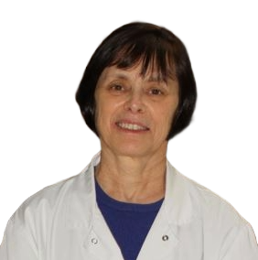
ISCL 2024 Lifetime Achievement Award
Martine Bagot, MD, PhD Chair and Professor, Department of Dermatology
Hopital Saint Louis, Université Paris Cité, Inserm U976 | France
In recognition of your outstanding contribution to the science and care of patients with cutaneous lymphomas

Slide 4
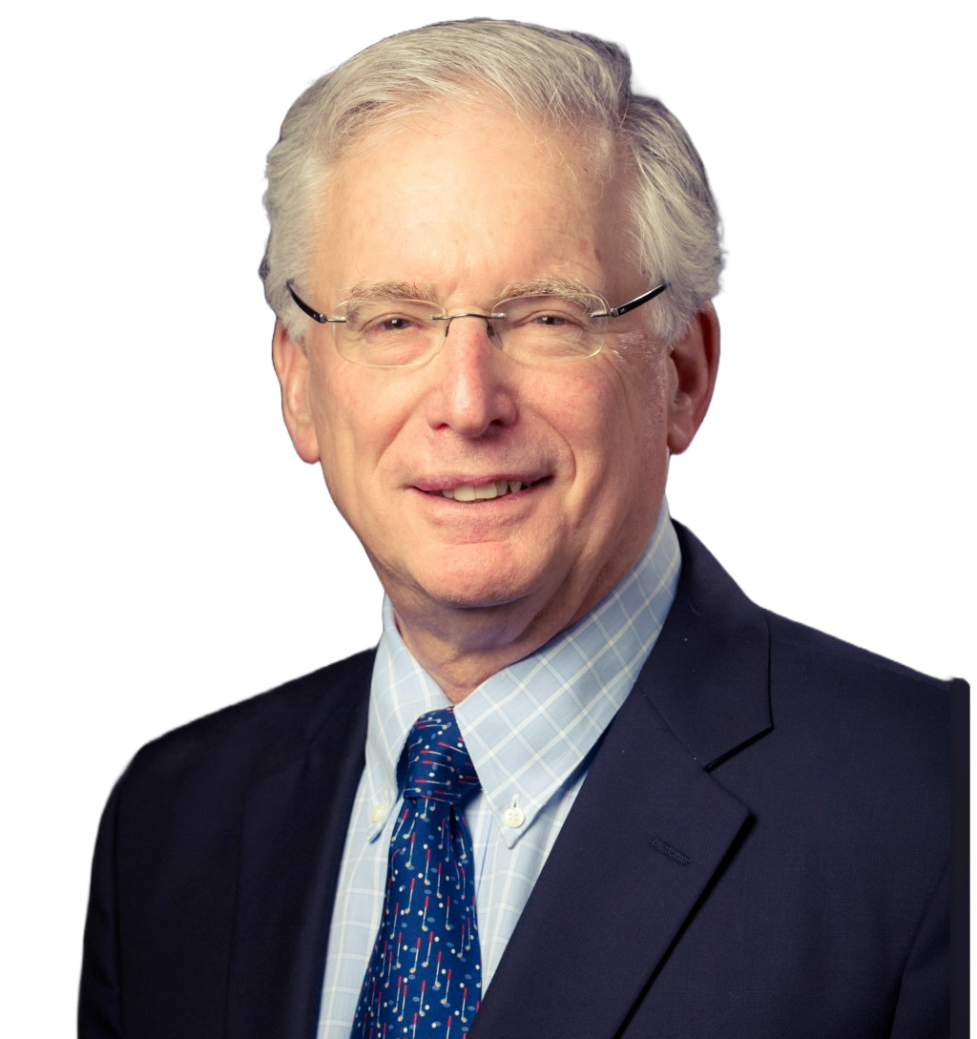
ISCL 2024 Lifetime Achievement Award
Richard L. Edelson, MD Anthony Brady Professor
Department of Dermatology
Yale University School of Medicine | U.S.
In recognition of your outstanding contribution to the science and care of patients with cutaneous lymphomas

Slide 5
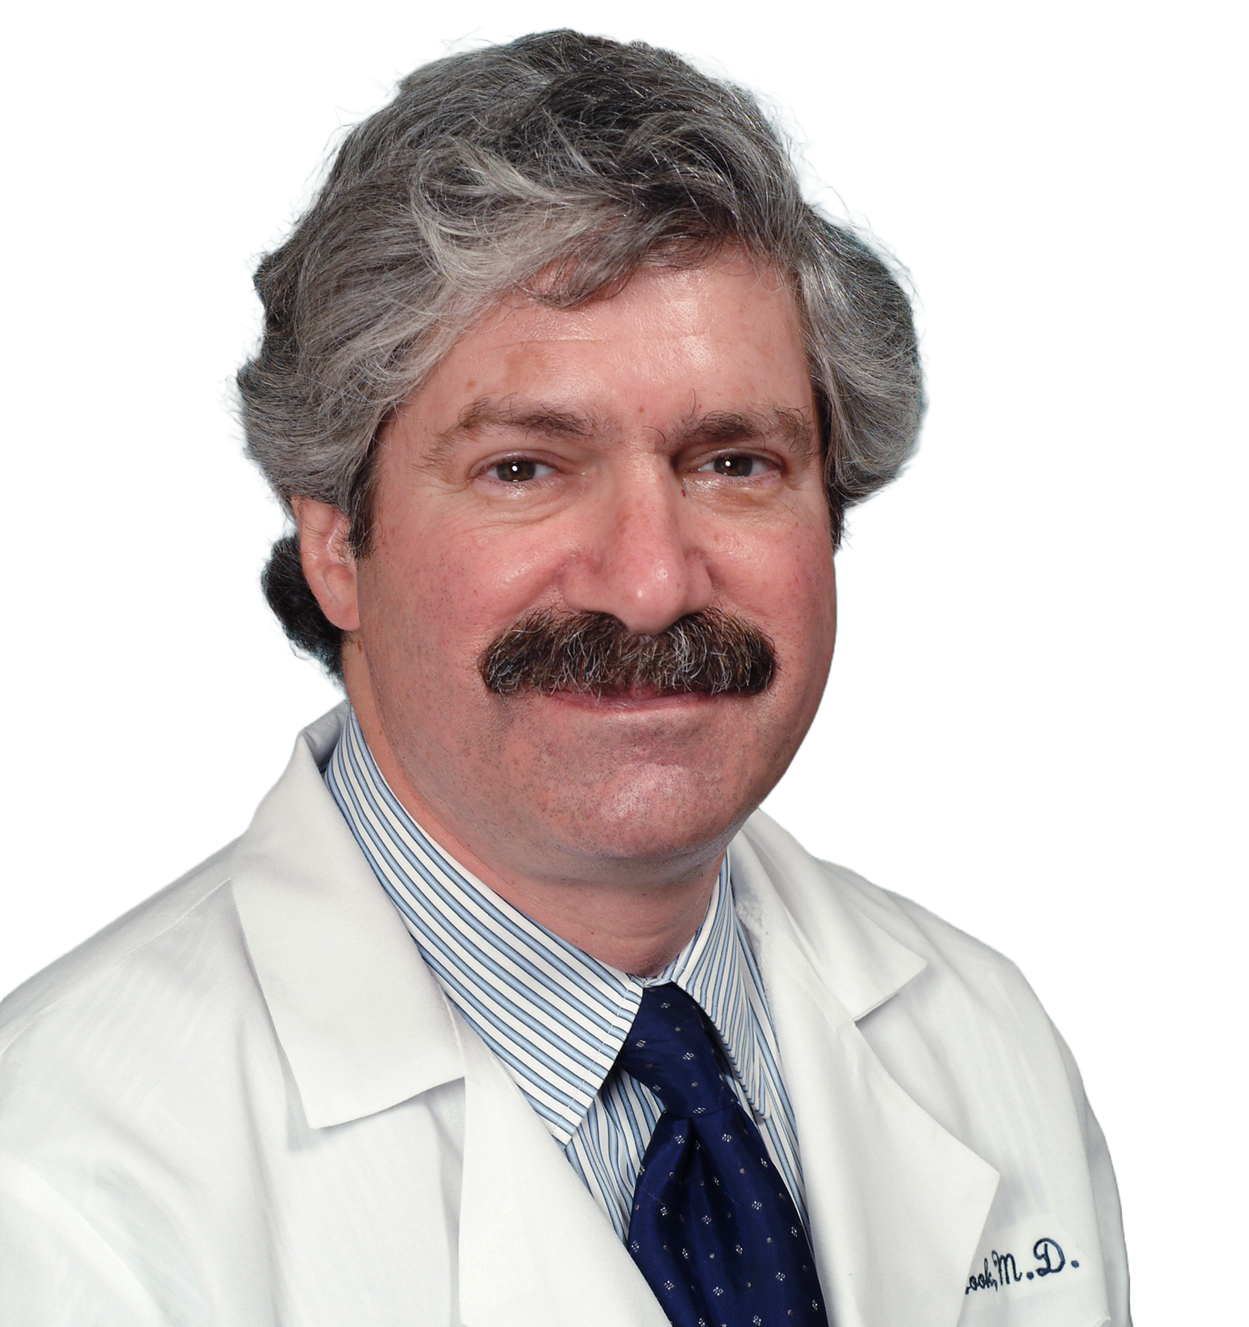
ISCL 2024 Lifetime Achievement Award
Alain H. Rook, MD Professor of Dermatology
Perelman School of Medicine
University of Pennsylvania | U.S.
In recognition of your outstanding contribution to the science and care of patients with cutaneous lymphomas

Slide 7
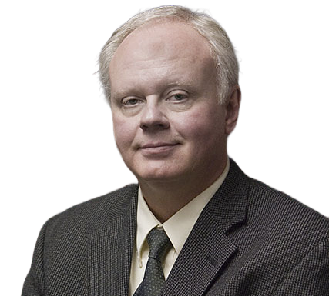
ISCL 2024 Lifetime Achievement Award
Gary S. Wood, MD Founding Chair and Professor Emeritus
Founding Director, Skin Diseases Research Center
Department of Dermatology University of Wisconsin-Madison | U.S.
In recognition of your outstanding contribution to the science and care of patients with cutaneous lymphomas

Slide 8
ISCL 2024 Lifetime Achievement Award
Alain H. Rook, MD Professor of Dermatology
Perelman School of Medicine
University of Pennsylvania | U.S.
In recognition of your outstanding contribution to the science and care of patients with cutaneous lymphomas

Slide 9
Thank you!

